Slide 1
A Good SRE is Hard to Find...
(...the power of apprenticeship!)
tw: @sweetpavement :: https://technical.ink/velocity-eu18

Slide 2
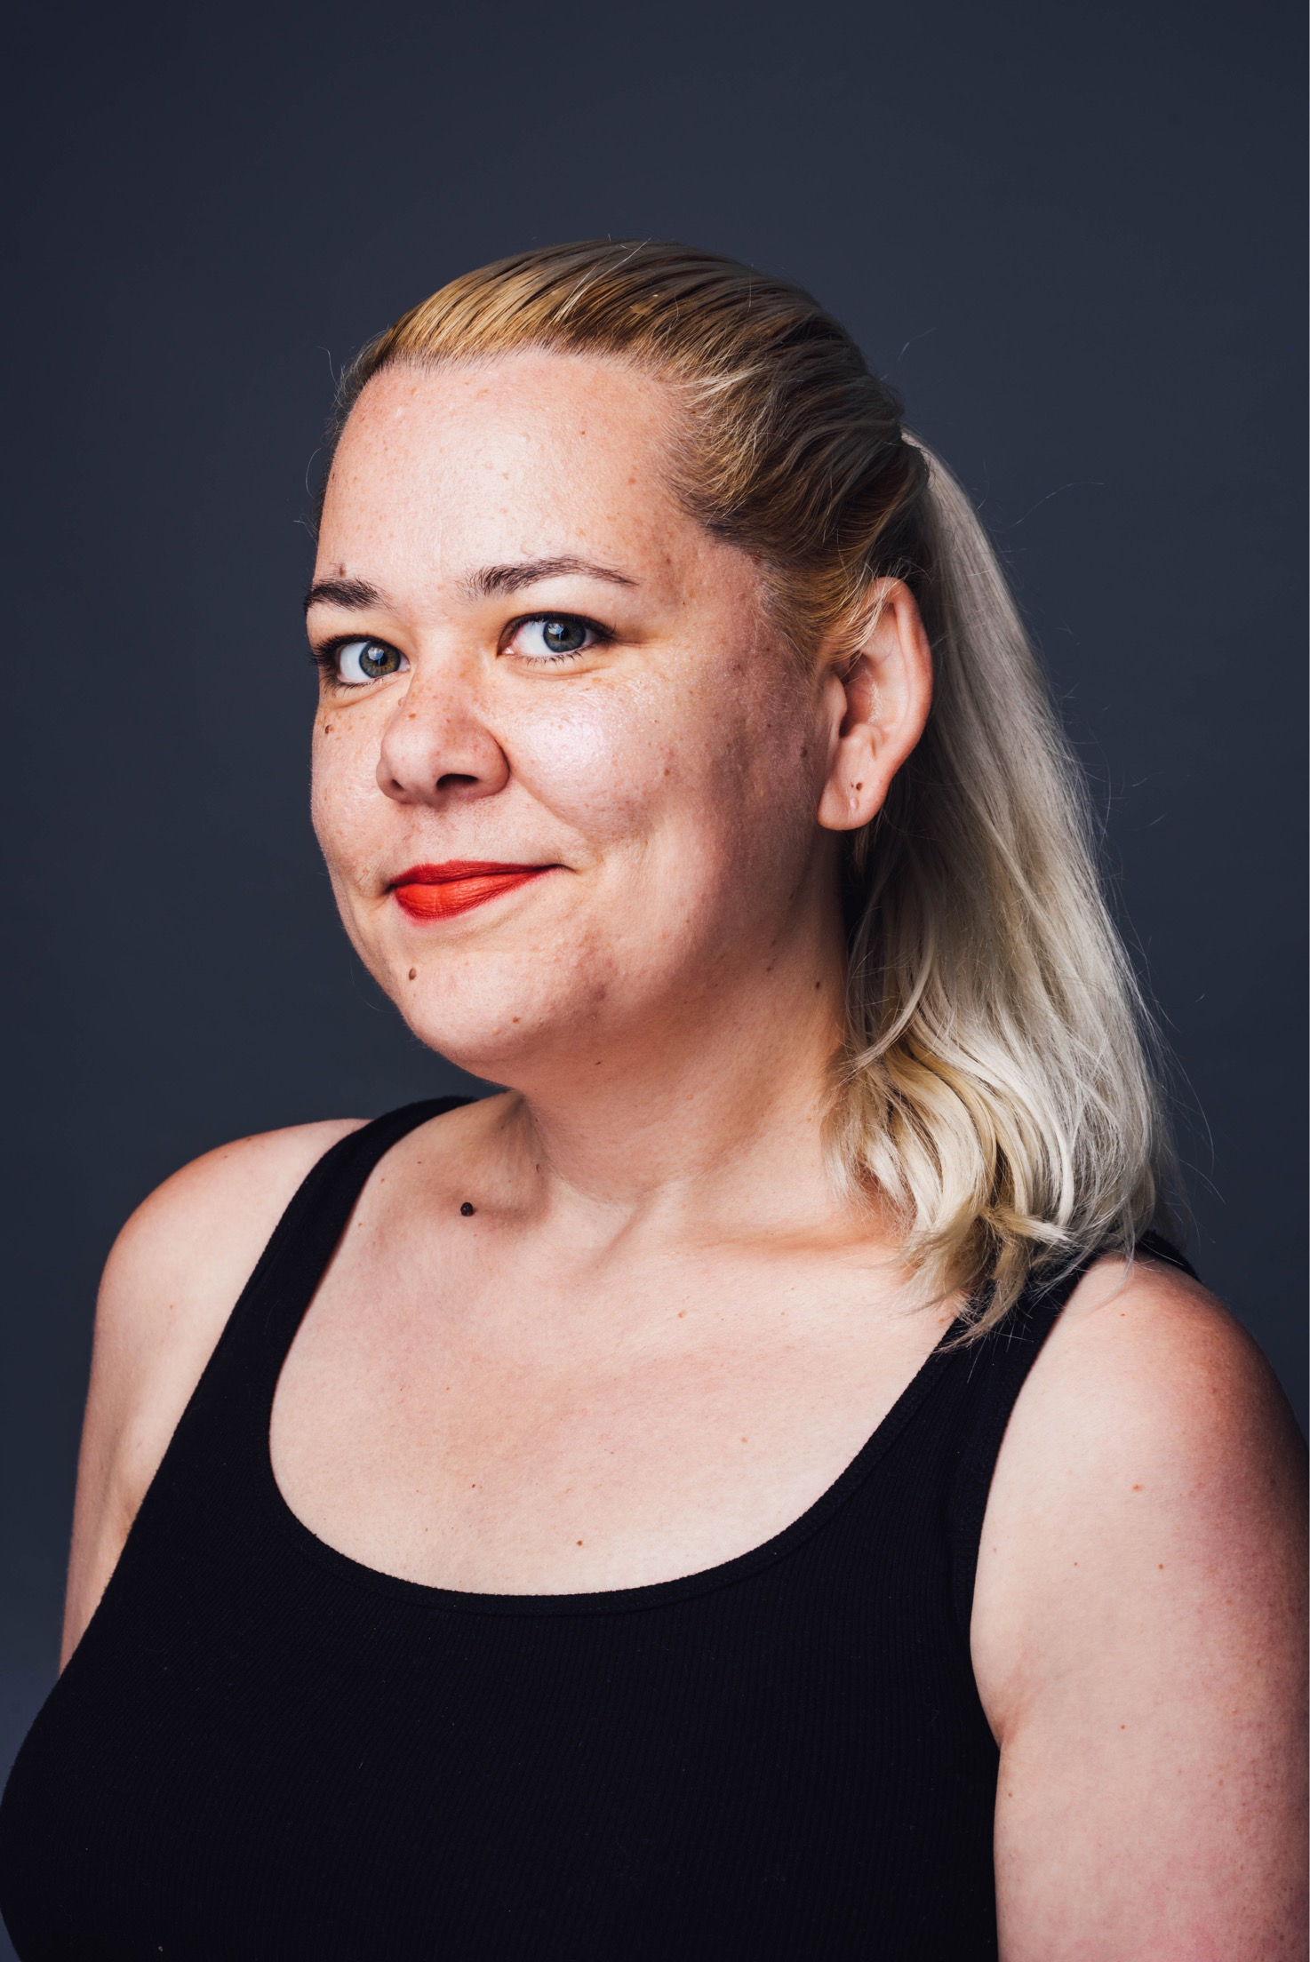
Who am I?
SRE @ Buzzfeed
Former Amazon Intern
Graduate of a coding academy
Favorite Language: the next one I learn!
tw: @sweetpavement :: https://technical.ink/velocity-eu18

Slide 3
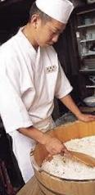
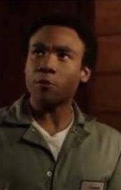
What is Apprenticeship?
Apprenticeship is a formal, experiential learning opportunity.
The apprentice benefits from the concrete connection of the theoretical and practical.
tw: @sweetpavement :: https://technical.ink/velocity-eu18

Slide 4
Listen and look…
...and the right candidate will appear!
tw: @sweetpavement :: https://technical.ink/velocity-eu18

Slide 5
“Finding the right candidate is about structuring your interview process to bring out the qualities in potential apprentices that make them great for the job.”
tw: @sweetpavement :: https://technical.ink/velocity-eu18

Slide 6
But...what do I look for?!
Technical hobbies like music, knitting, photography or cooking
Tends to be curious and dive into new skills or interests
tw: @sweetpavement :: https://technical.ink/velocity-eu18

Slide 7
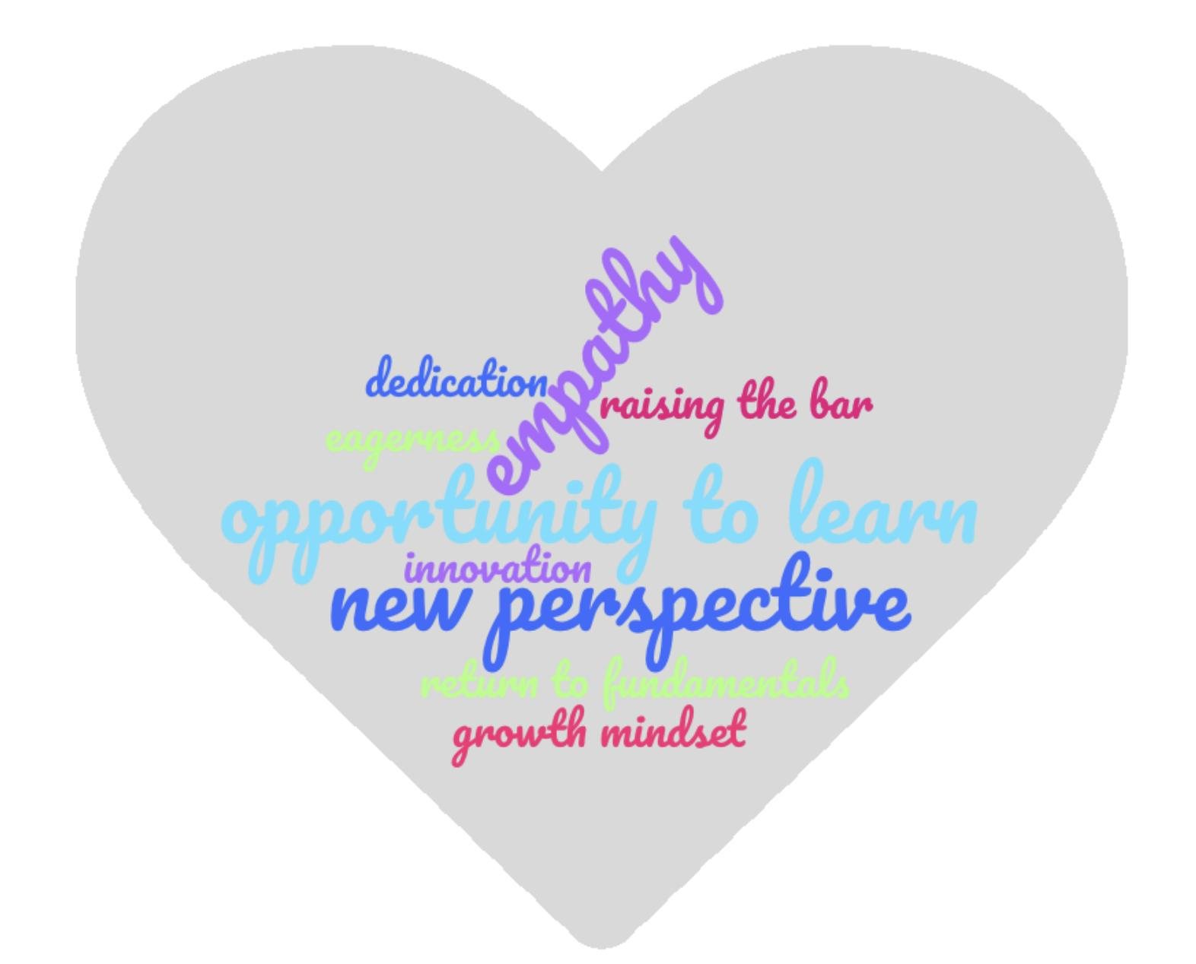
Benefits of Apprentices!
tw: @sweetpavement :: https://technical.ink/velocity-eu18

Slide 8
An Apprenticeship Framework:
Sandbox - ownership/empowerment
Shadow - active learning/guided practice
Exposure - opportunity/passion
Include - contribute/participate
Ritual - stability/confidence
tw: @sweetpavement :: https://technical.ink/velocity-eu18

Slide 9
Sandbox
tw: @sweetpavement :: https://technical.ink/velocity-eu18

Slide 10
“Apprentices learn confidence through ownership and maintenance of their own sandbox.”
tw: @sweetpavement :: https://technical.ink/velocity-eu18

Slide 11
Shadow
tw: @sweetpavement :: https://technical.ink/velocity-eu18

Slide 12
“[The apprentice’s first solo] can be uncomfortable for both the apprentice and the mentor...this is not a lack of confidence in the apprentice, it’s a sign you need more automation and guardrails.”
tw: @sweetpavement :: https://technical.ink/velocity-eu18

Slide 13
Exposure
tw: @sweetpavement :: https://technical.ink/velocity-eu18

Slide 14
“The challenge is that an apprentice will be passionate about many things and over-invest. Your whole SRE team will benefit from modeling good time management and work-life balance skills for the apprentice.”
tw: @sweetpavement :: https://technical.ink/velocity-eu18

Slide 15
Include
tw: @sweetpavement :: https://technical.ink/velocity-eu18

Slide 16
“When including your apprentice, recognize and celebrate their contributions...without exceptionalizing them. Apprentices are real engineers with valuable skills and knowledge.”
tw: @sweetpavement :: https://technical.ink/velocity-eu18

Slide 17
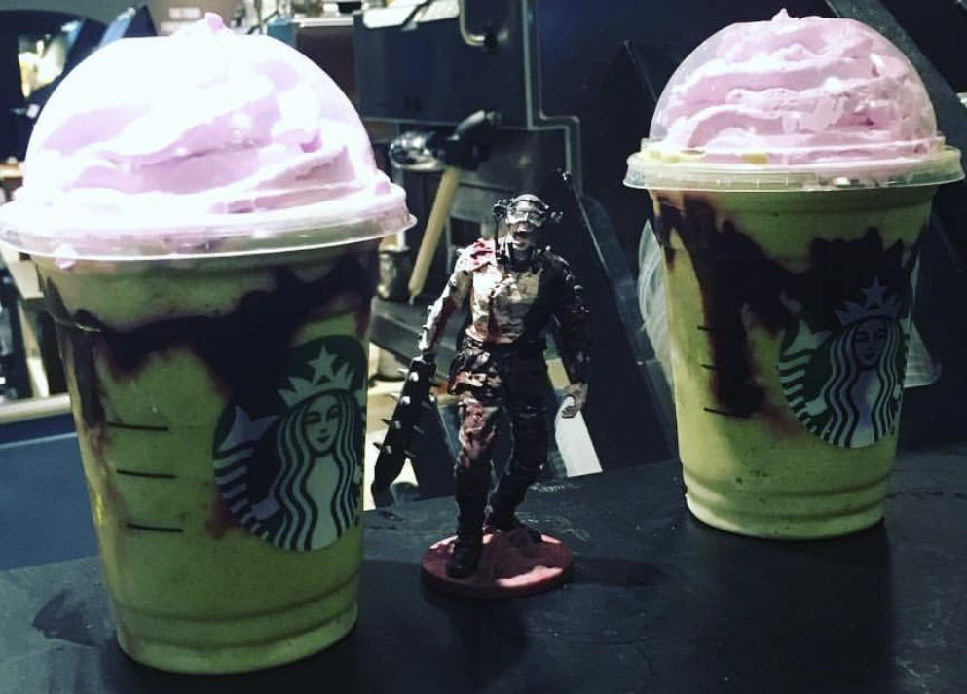
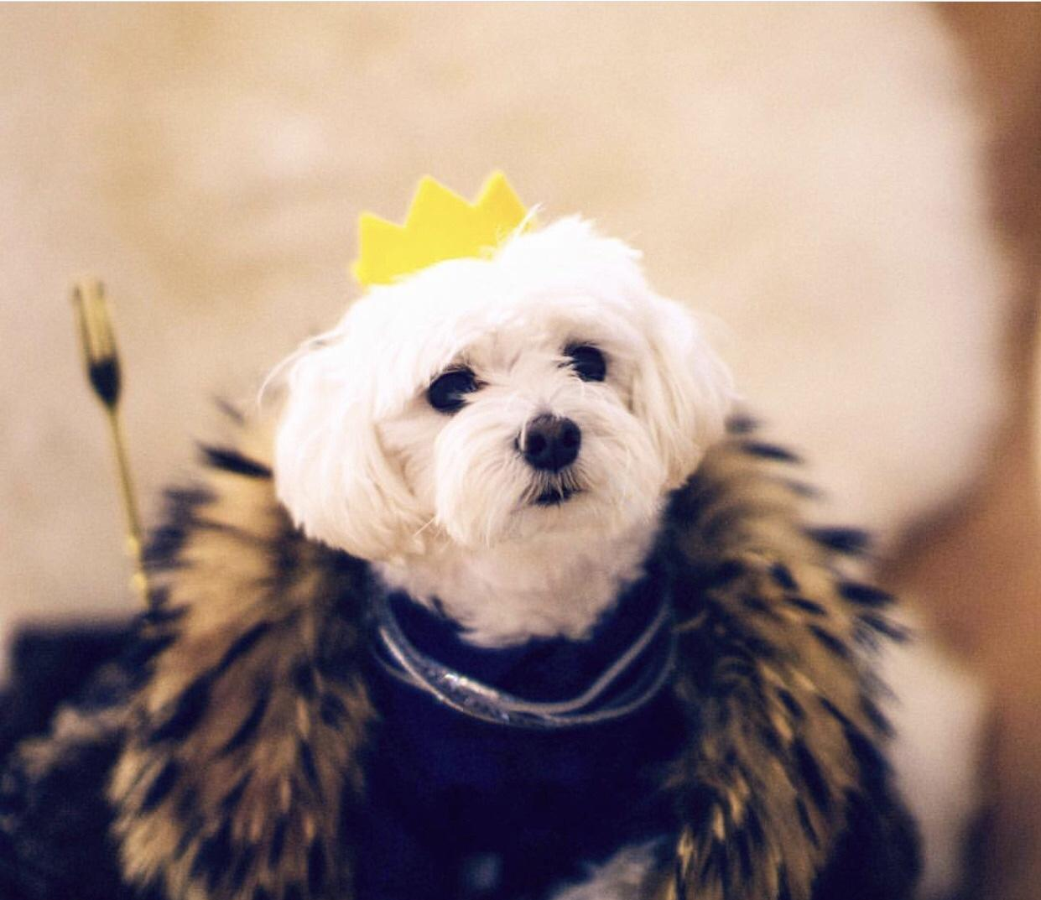
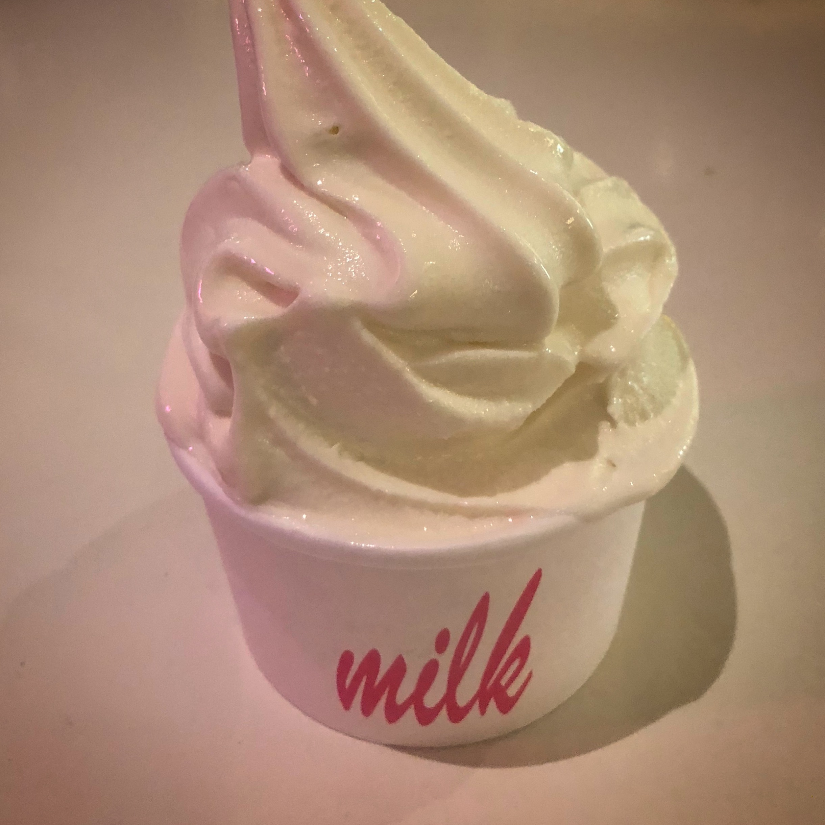
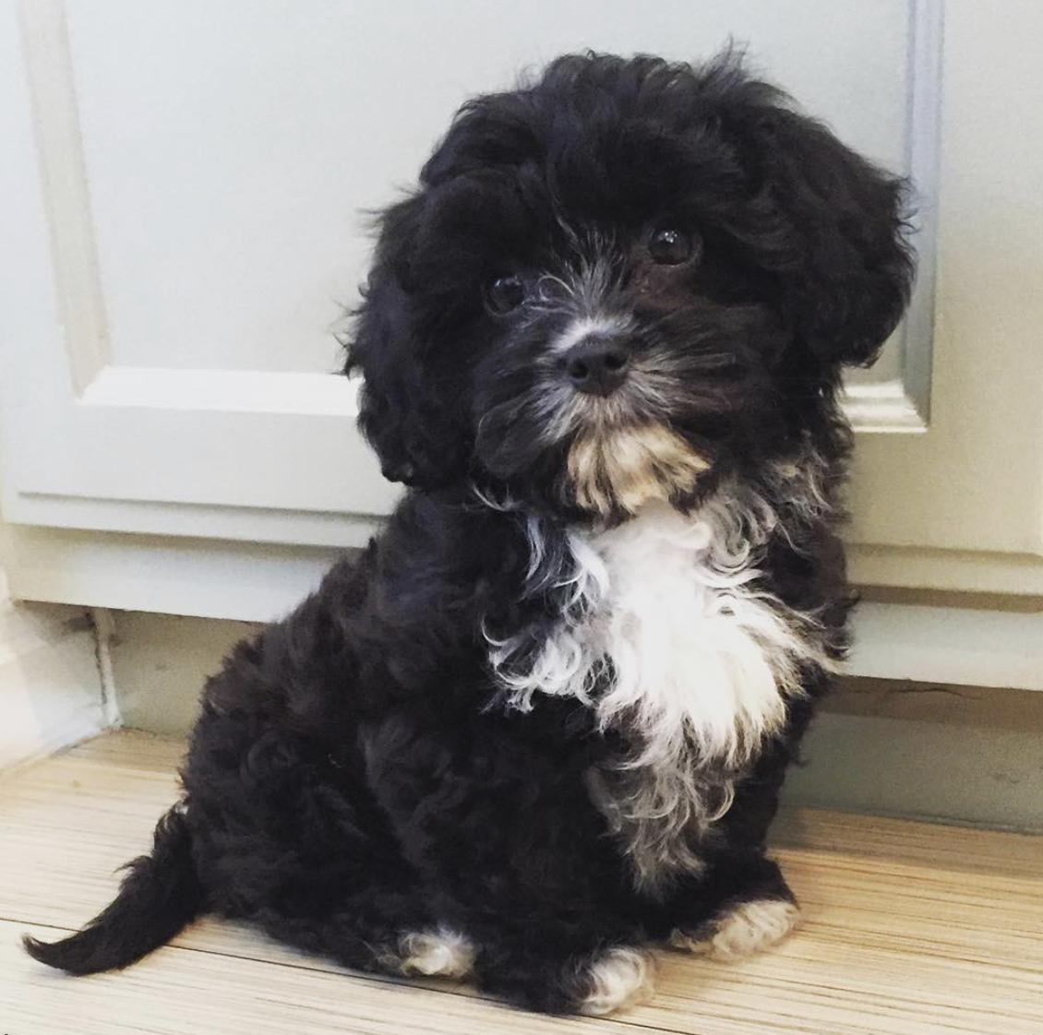
Ritual
tw: @sweetpavement :: https://technical.ink/velocity-eu18

Slide 18
“Rituals help an apprentice find stable ground when they’re uncertain, and stable ground gives the apprentice a foundation for providing their best work.”
tw: @sweetpavement :: https://technical.ink/velocity-eu18

Slide 19
WARNING: Apprentices need extra empathy!
Every engineer has:
...bad days / blocked work / frustration / struggle…
But an apprentice will not know:
...this is normal / this will pass / they can ask for help…
So bring extra empathy!
tw: @sweetpavement :: https://technical.ink/velocity-eu18

Slide 20
To Sum Up!
Apprenticeship is a formal, experiential learning opportunity; it requires structure. By following a framework that includes hands-on experimentation and mentor-guided experience, you’ll be growing new (great) SREs in no time.
tw: @sweetpavement :: https://technical.ink/velocity-eu18

Slide 21
And remember...
Check in on your apprentice’s mental health and struggles; they’ll benefit from the empathy!
tw: @sweetpavement :: https://technical.ink/velocity-eu18

Slide 22
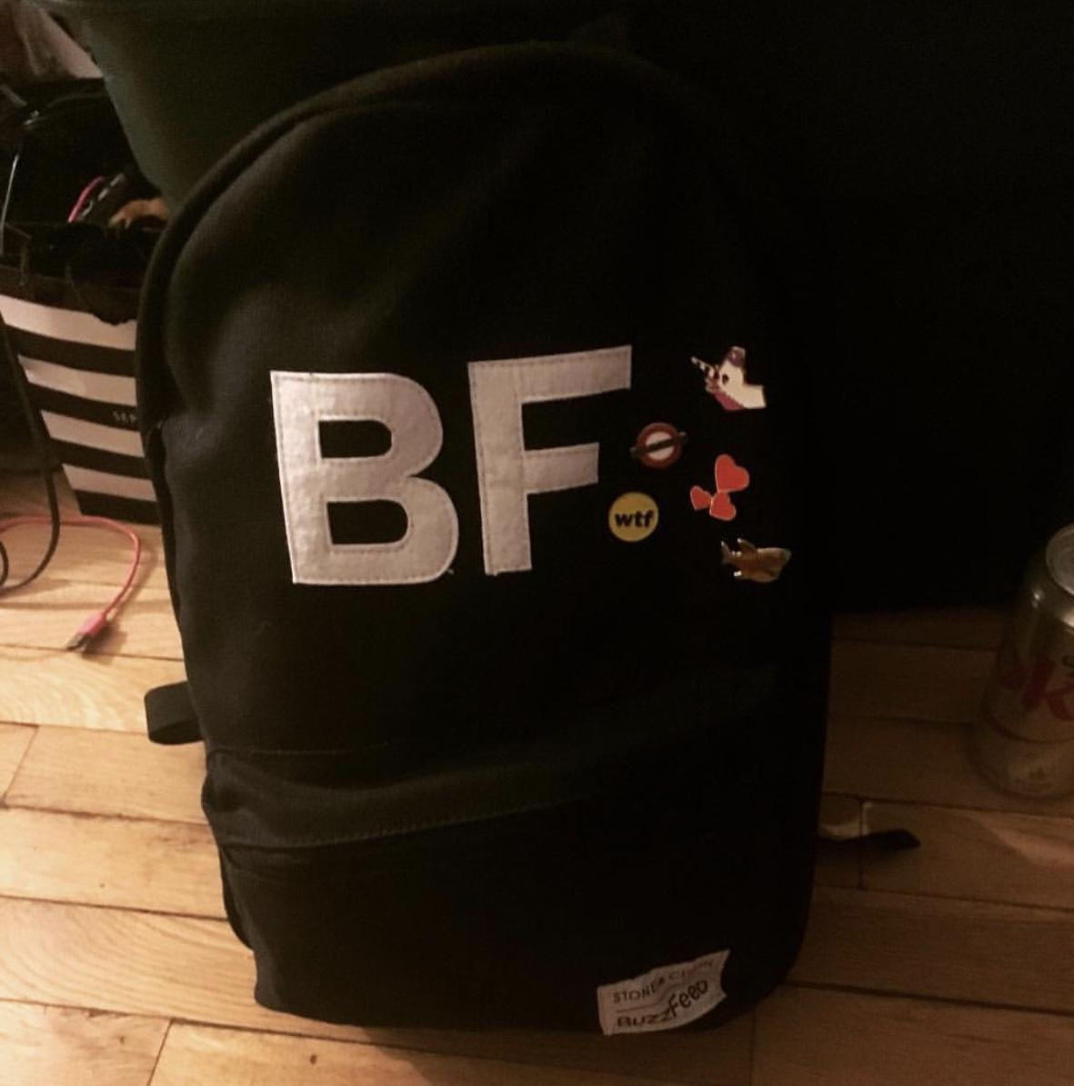
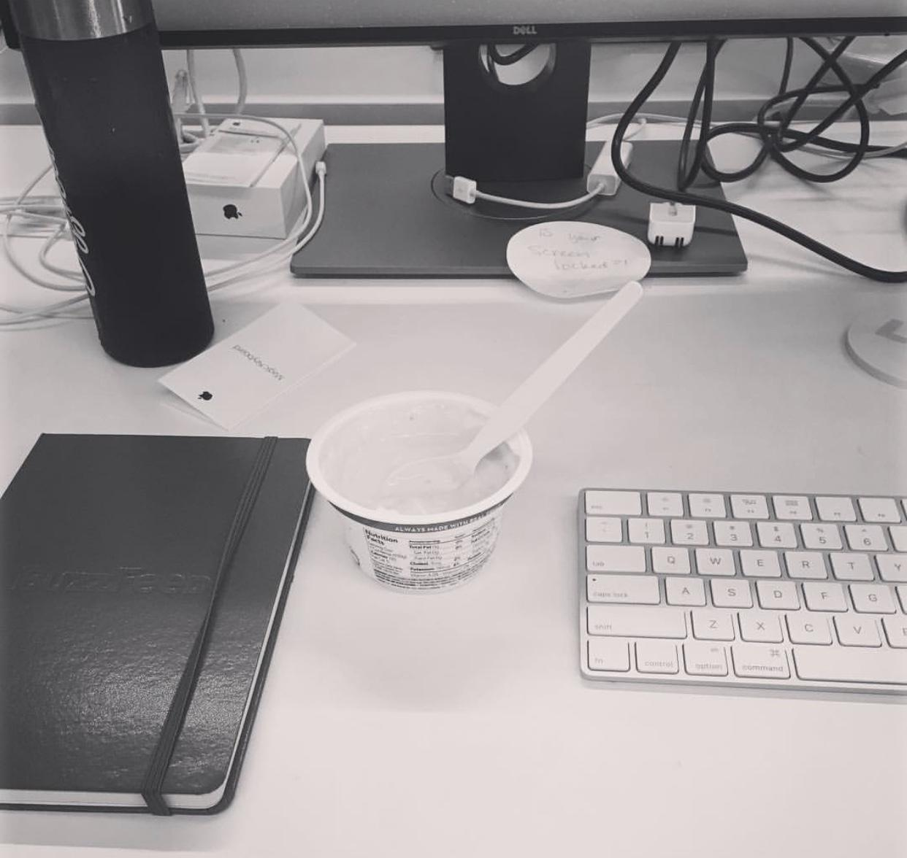
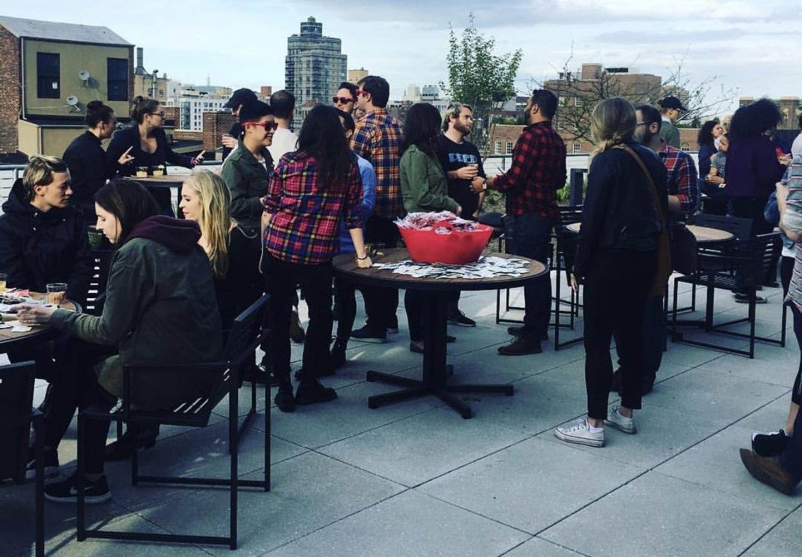
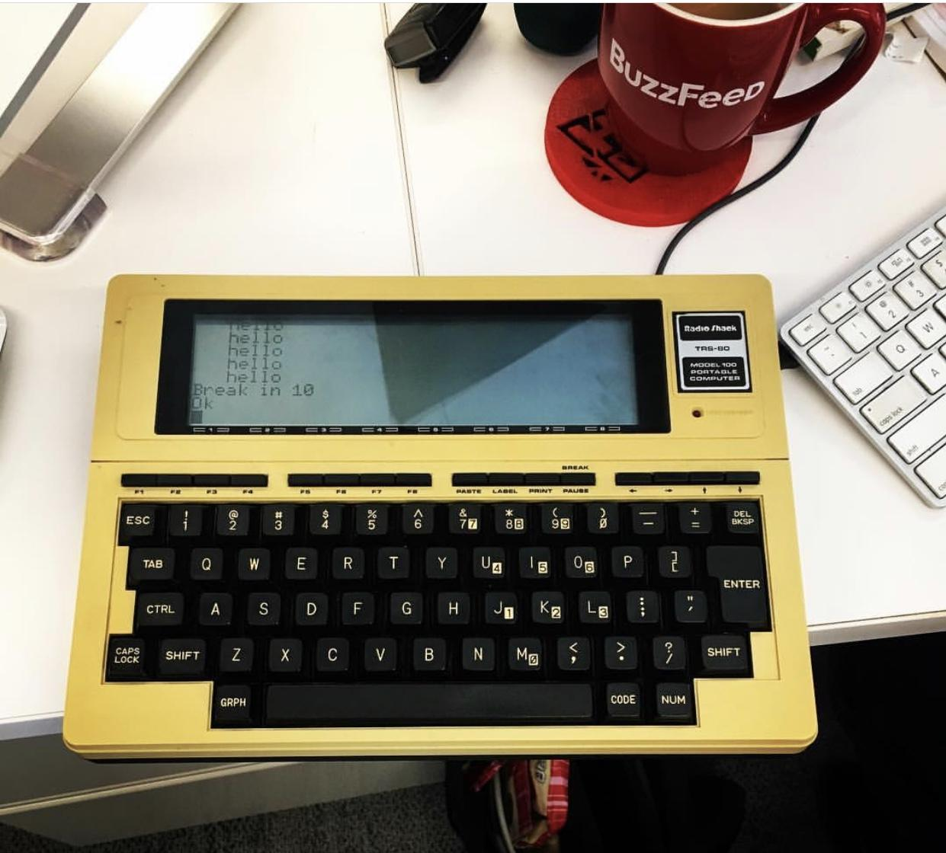
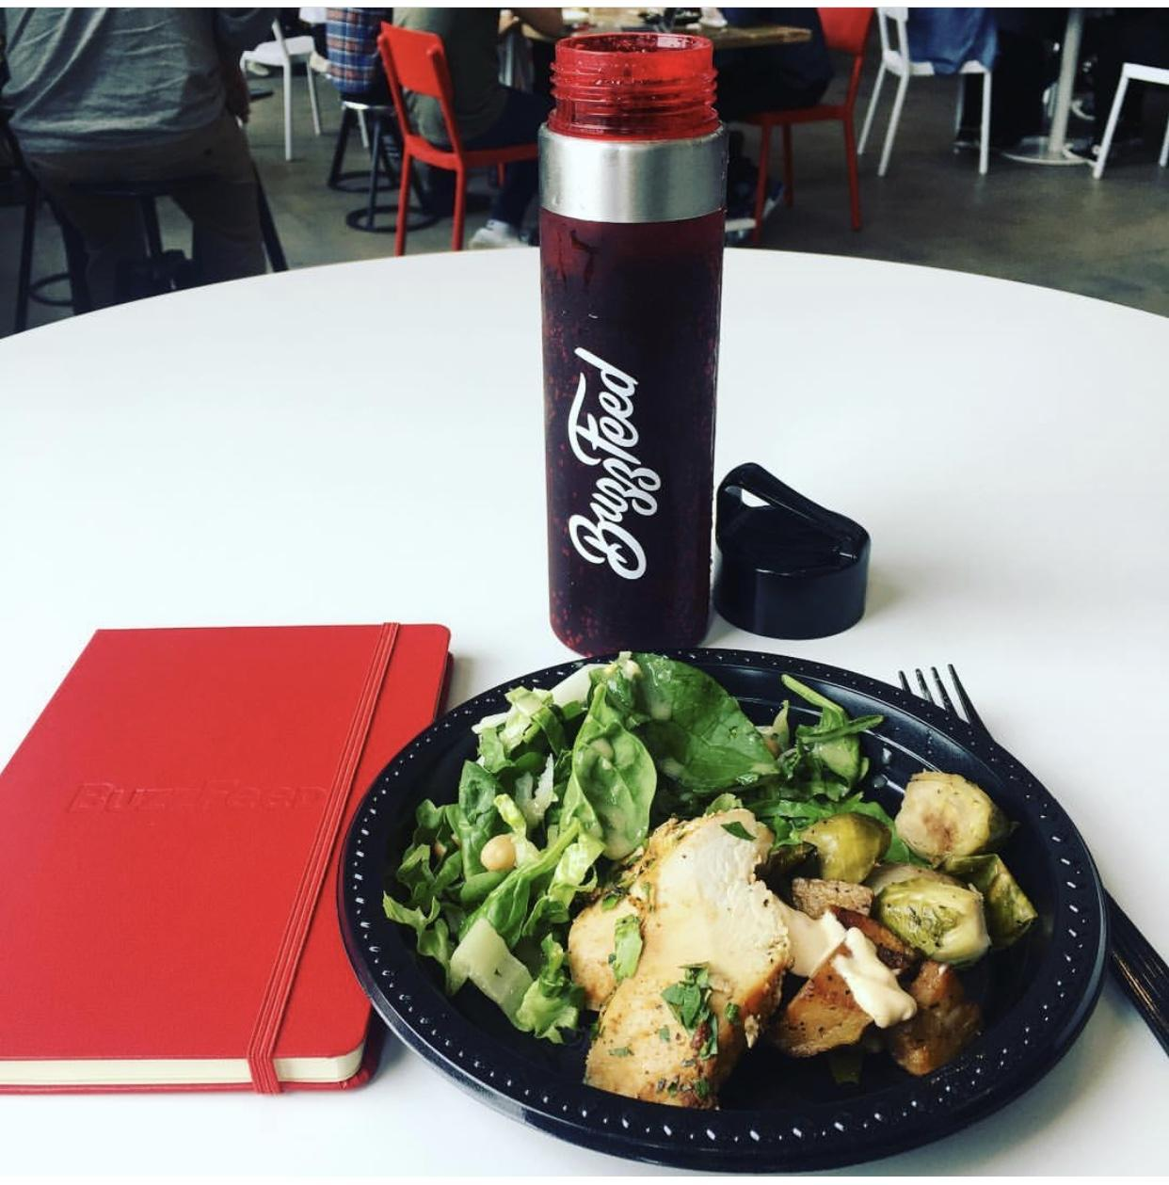
THANK YOU!
If you want to follow up with questions or to chat further, please feel free to:
e-mail: rowan.cota@buzzfeed.com
tweet: @sweetpavement
github: @cotarg
tw: @sweetpavement :: https://technical.ink/velocity-eu18

